Slide 1
HINTELLECT
Ai that reviews, you that thinks

Slide 2
Why code reviews matter
Errors are bound to be made. In fact, we believe errors are good.
They are the chance to learn from mistakes, which you are going to remember forever.
So instead of understanding and having fun with code, new coders jump into solutions directly.
They do not let themselves understand and learn the language.
This is why code review is important.
Making mistakes and learning from it, not making mistakes and just moving forward.

Slide 3
Problem statement
Manually reviewing code for errors and optimization is time-consuming, prone to oversight, and hinders developer growth. There is a need for an intelligent system that detects syntax and logical errors, rates code quality, and provides insightful hints—making smart coders while enhancing efficiency.

Slide 4
Our solution
We are providing a website without any external distractions.
It will simply review your code and provide the user with
1. Code rating.
2. Errors.
3. Optimization as a fun hint.
It will keep the users focused on the web page and provide solution immediately.
“Analyze, Improve, Optimize!”

Slide 5
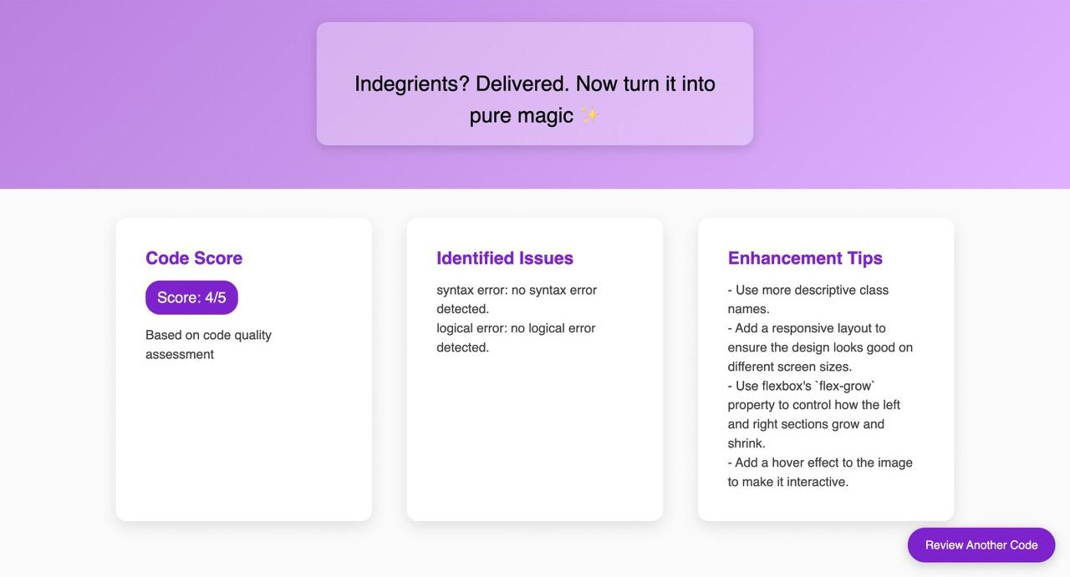
Key features
Key features are:
Code score
Identified Issues
Enhancement tips
“Turn Bugs into Brilliance!”

Slide 6
Tech stack
Frontend:
Bootstrap – For responsive and modern UI design
HTML, CSS, JavaScript – Core web technologies for structuring and styling
Backend:
Flask – Handling API requests and backend logic in Python
Express.js – Managing routes and server-side logic in JavaScript
AI Integration & AI Processing:
Python (Flask) – To integrate AI-based code review features
Google AI API – For leveraging AI-powered insights
Other Tools & Libraries:
Axios – For API communication in the frontend

Slide 7
Future scope
UI improvement
Chat bot integration to keep a track of progress

Slide 8
THANK YOU !

